Slide 1
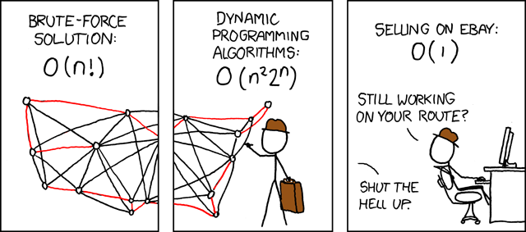
Dynamic Programming
Hongning Wang
CS@UVA

Slide 2
Outline
Policy evaluation
Policy iteration
Value iteration

Slide 3
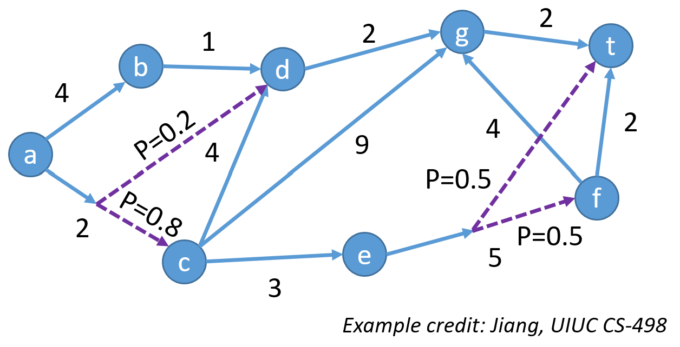
Dynamic programming
Both a mathematical optimization method and a computer programming method
  Shortest path
  Edit distance
  Viterbi decoding
  Matrix chain multiplication

Slide 4
Recap: Bellman equation for value function
A closer look with a matrix form
$$v_{π}\left(s\right)=r\left(s,π\left(s\right)\right)+γp\left(s^{′} | s,π\left(s\right)\right)v_{π}(s′)$$
$$V_{π}=R_{π}+γP_{π}^{ss′}V_{π}$$
Complexity: $O({\left|S\right|}^{3})$
$$(I−γP_{π}^{ss′})V_{π}=R_{π}$$
State occupancy matrix
$$V_{π}={\left(I−γP_{π}^{ss^{′}}\right)}^{−1}R_{π}$$
$$d_{π}^{s}\left(s^{′}\right)=E\left[\sum_{t=1}^{∞}{γ^{t−1}Δ\left(s_{t}=s^{′}\right)|s_{1}=s,π}\right]$$
Proof of the solution’s existence and uniqueness?
Each row depicts the discounted probability of visiting state $s’$ starting from state $s$

Slide 5

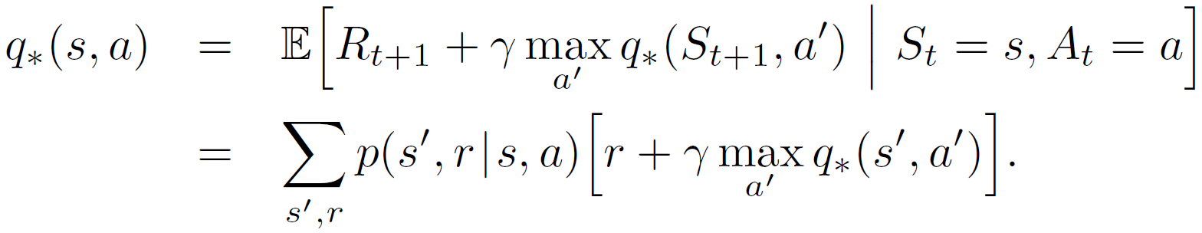
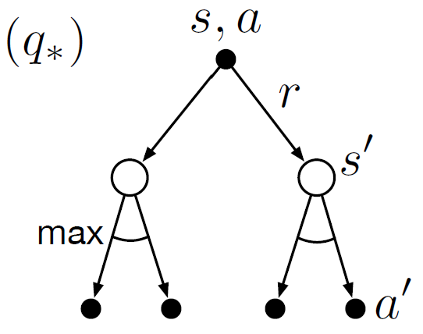
Recap: Bellman equation for optimal action-value function
It is also in a similar and special form
No closed form solution!
Q: How do we really find it?
A: Solving a set of system equations, one equation for each state-action pair!
Requirements:
Known environment dynamics
Markovian states
Abundant computational power
Otherwise, we will approximate it!

Slide 6
Dynamic programming
A general problem solving principle
  Break a complex problem into simpler sub-problems recursively
  Combine solutions of sub-problems
Key properties
  Optimal substructure
    An optimal solution can be constructed from optimal solutions of its sub-problems
  Overlapping sub-problems
    Sub-problems recur repeatedly
    Solutions to them can be reused

Slide 7
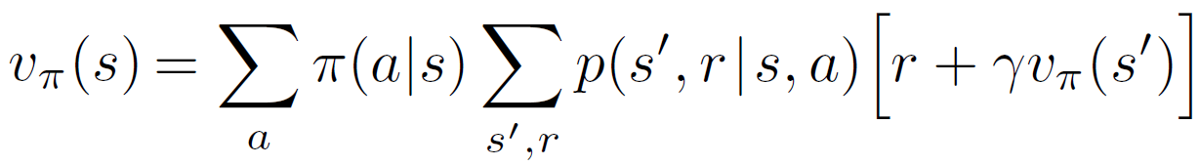

Policy evaluation
Assume a known environment described by a finite MDP
  $p(s^{′},r|s,a)$
  Finite state space and action space
Compute state-value function $v_{π}$
  Bellman equation
Recurring
All given

Slide 8
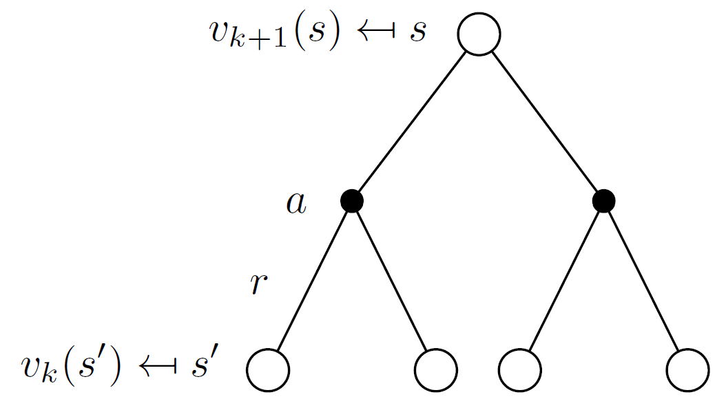
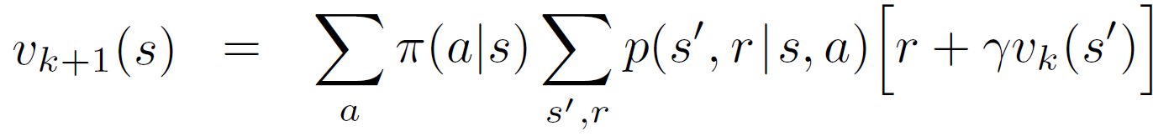

Policy evaluation
Assume a known environment described by a finite MDP
  $p(s^{′},r|s,a)$
  Finite state space and action space
Compute state-value function $v_{π}$
  Iterative policy evaluation
Bellman Expectation Backup
Current iteration
Last iteration

Slide 9
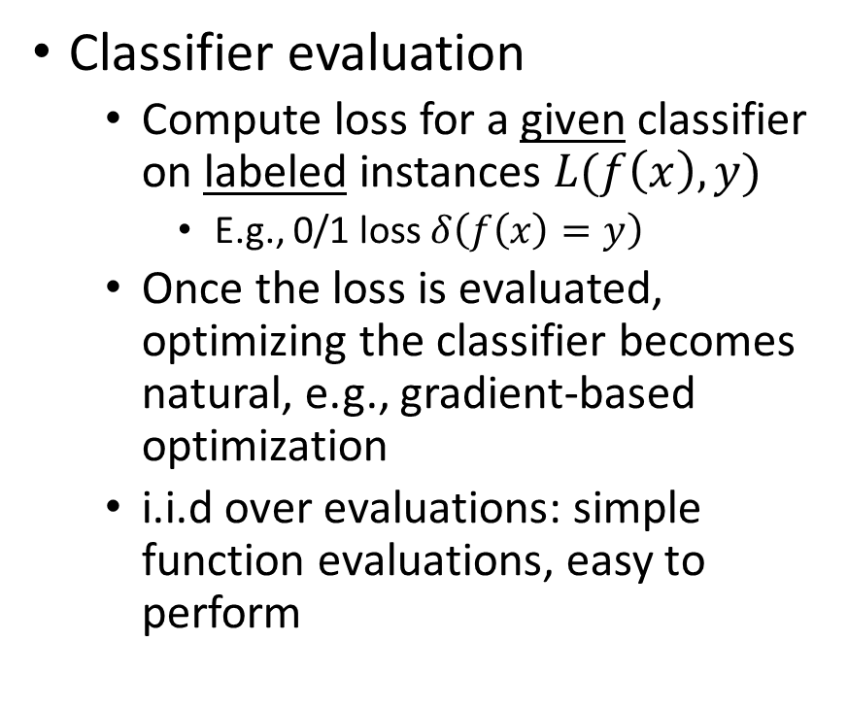
Understanding policy evaluation
Policy evaluation
  Compute value function for a given policy under a given environment
  Once the values of states are known, policy improvement becomes natural, e.g., take the action with the highest value
  Dependent actions and states, more complicated to perform
Classifier evaluation
  Compute loss for a given classifier on labeled instances $L(f\left(x\right), y)$
    E.g., 0/1 loss $δ\left(f\left(x\right)=y\right)$
  Once the loss is evaluated, optimizing the classifier becomes natural, e.g., gradient-based optimization
  i.i.d over evaluations: simple function evaluations, easy to perform

Slide 10
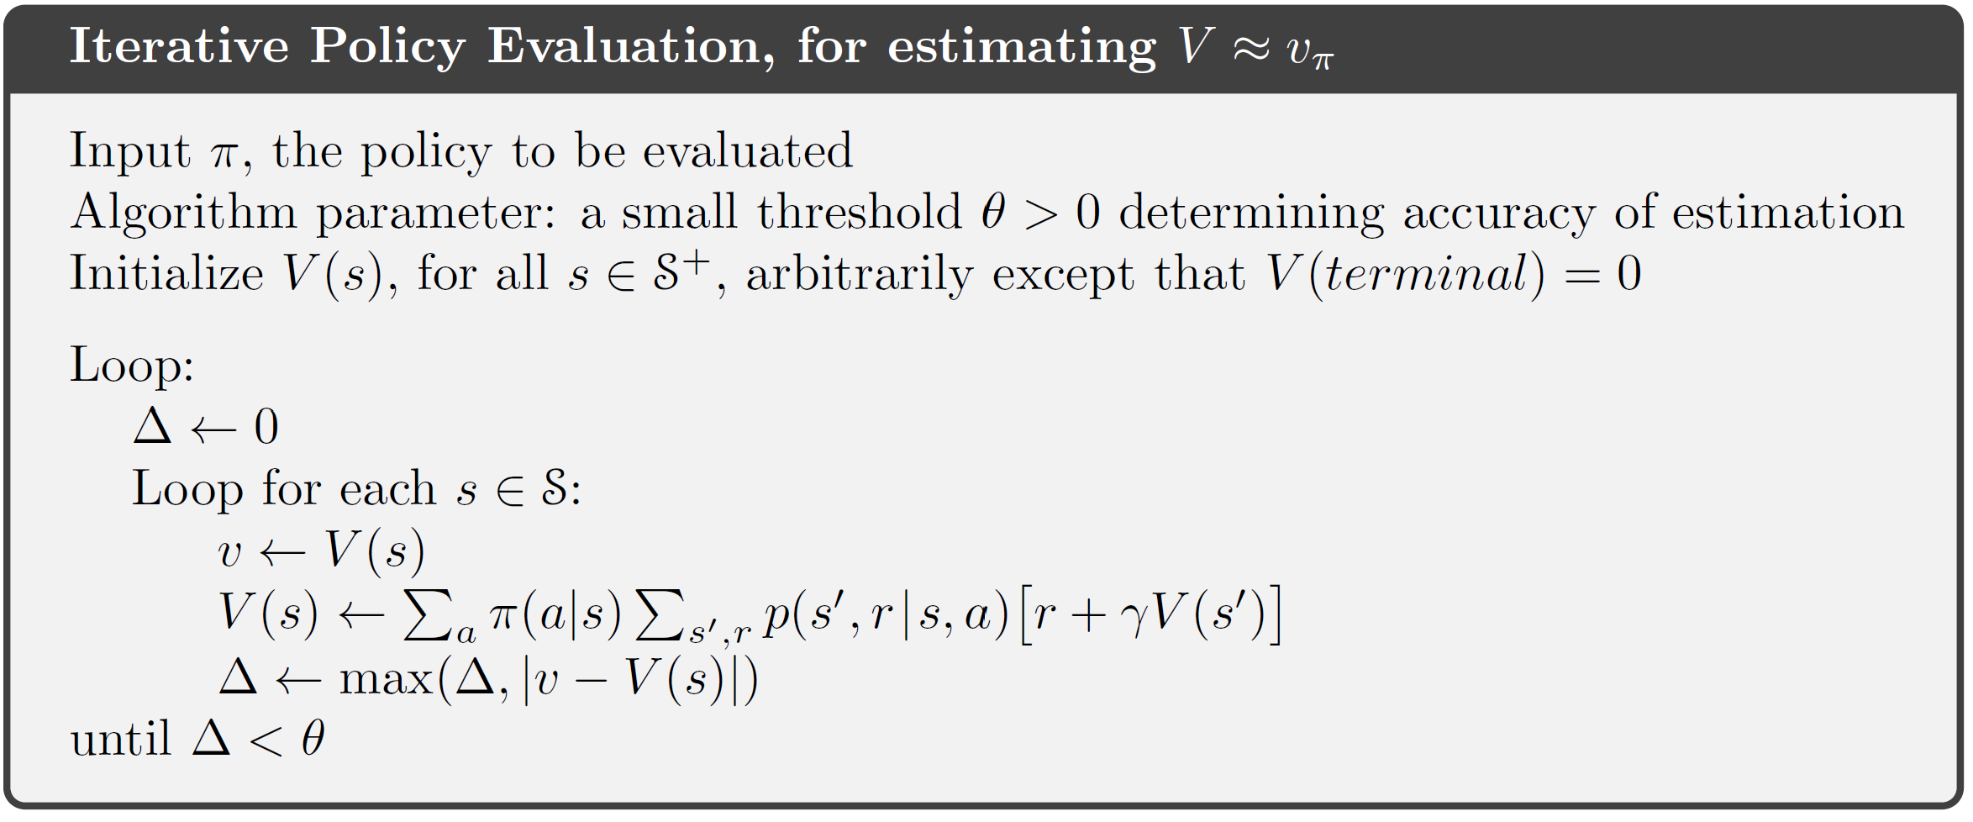

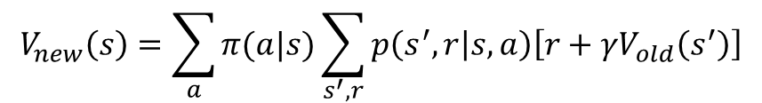
  Iterative policy evaluation
$$V_{new}\left(s\right)=\sum_{a}{π(a|s)}\sum_{s^{′},r}{p\left(s^{′},r | s,a\right)\left[r+γV_{old}\left(s^{′}\right)\right]}$$
But will it stop and correctly converge?
Complexity?
$$O(\left|A\right|×{\left|S\right|}^{2})$$
Asynchronous value update!
Essentially a fixed point iteration method.

Slide 11

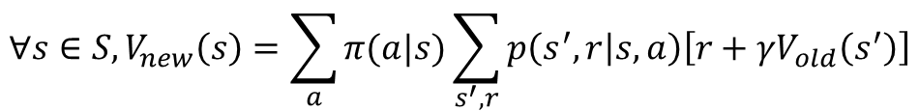
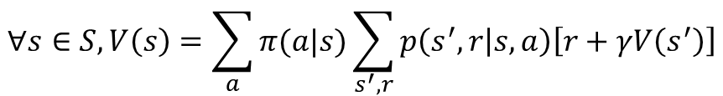
Asynchronous Dynamic Programming
In-Place Dynamic Programming
  Synchronous policy evaluation stores two copies of value function
  In-place policy evaluation only needs one copy of value function
$$∀s∈S, V_{new}\left(s\right)=\sum_{a}{π(a|s)}\sum_{s^{′},r}{p\left(s^{′},r | s,a\right)\left[r+γV_{old}\left(s^{′}\right)\right]}$$
$$V_{old}←V_{new}$$
$$∀s∈S, V\left(s\right)=\sum_{a}{π(a|s)}\sum_{s^{′},r}{p\left(s^{′},r | s,a\right)\left[r+γV\left(s^{′}\right)\right]}$$
Does the update order matter?
Usually converges faster

Slide 12
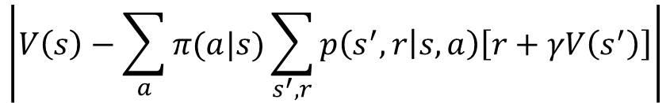
Asynchronous Dynamic Programming
Prioritized sweeping
  Bellman error
  Start with state with the largest error
  Then update the error of affected states
Real-time backup
  Only update the states recently visited by the agent
$$\left|V\left(s\right)−\sum_{a}{π(a|s)}\sum_{s^{′},r}{p\left(s^{′},r | s,a\right)\left[r+γV\left(s^{′}\right)\right]}\right|$$
Will it ever stop?

Slide 13
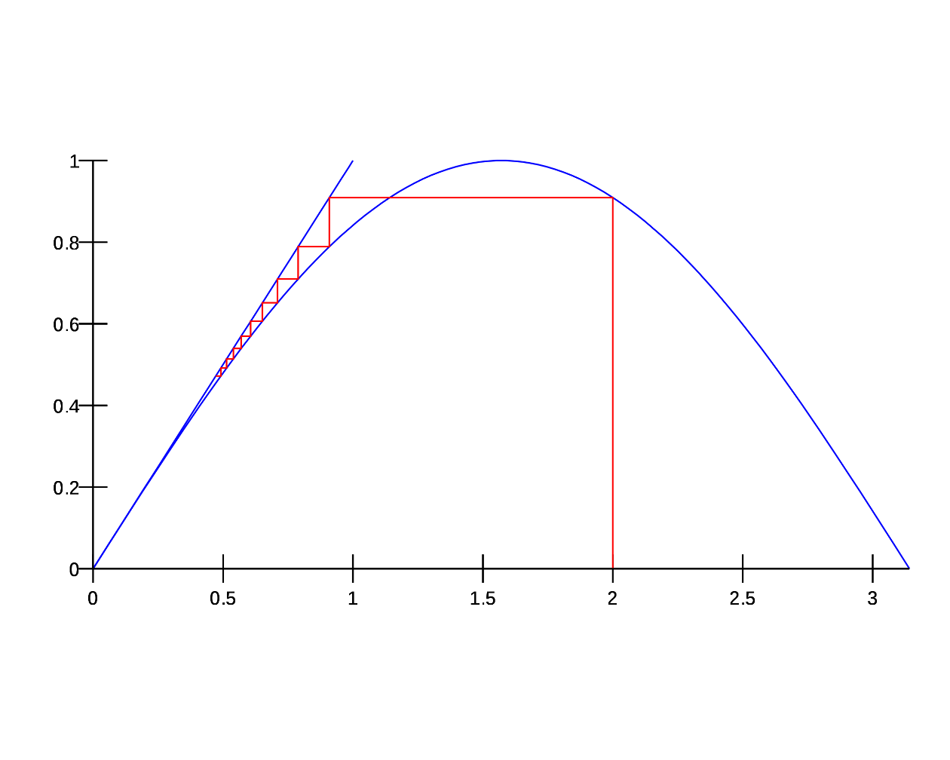

Bellman expectation backup is a contraction mapping
Contraction mapping
  $d\left(f\left(x\right),f\left(y\right)\right)≤γd(x,y)$ where $γ ∈(0,1)$
  E.g., $x=sin⁡(x)$

Slide 14



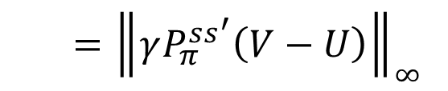
Bellman expectation backup is a contraction mapping
Bellman expectation backup operator
  $Γ_{π}(V)=R_{π}+γP_{π}^{ss′}V$
  It is a $γ$-contraction
  $${\left\|Γ_{π}\left(V\right)−Γ_{π}\left(U\right)\right\|}_{∞}=\left\|\left(R_{π}+γP_{π}^{ss′}V\right)−\left(R_{π}+γP_{π}^{ss′}U\right)\right\|$$
  $$={\left\|γP_{π}^{ss^{′}}\left(V−U\right)\right\|}_{∞}$$
  $$≤γ{\left\|V−U\right\|}_{∞}$$
Converge exponentially fast!

Slide 15
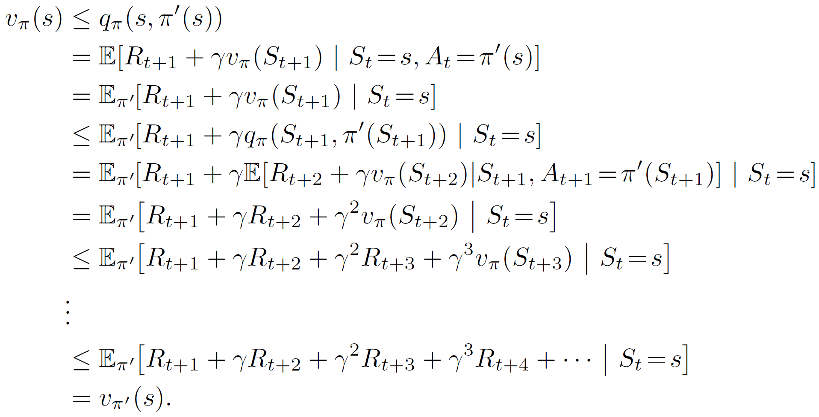

Policy improvement
Policy improvement theory
  Denote $π$ and $π′$ as two deterministic policies, if $∀s∈S$ we have $q_{π}\left(s,π^{′}\left(s\right)\right)≥v_{π}(s)$, then $v_{π′}\left(s\right)≥v_{π}(s)$
Keep expanding by definition, until hit all states

Slide 16
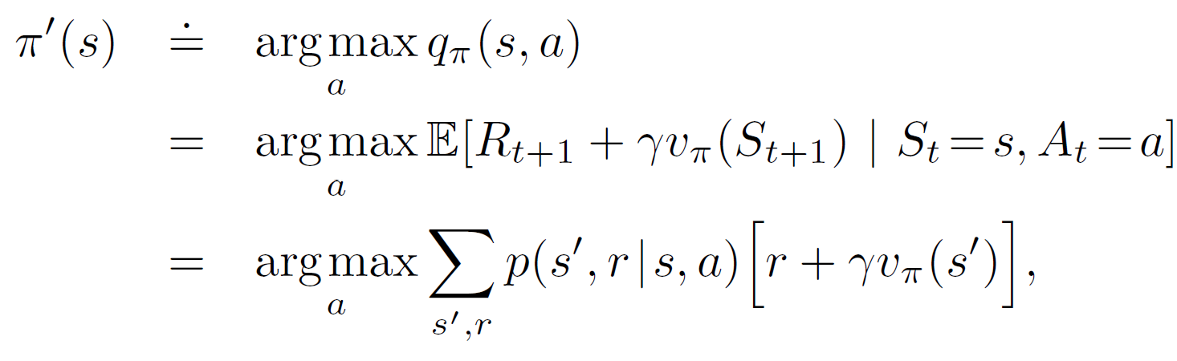
Policy improvement
Improvement achieved by a “greedy” search
At each state, take the best action at the moment
One step look ahead!
What if no change happens? The optimal policy has been found!
Will it stop? Yes, the proof is similar as in policy evaluation!

Slide 17
Policy improvement
Improvement achieved by a “greedy” search
$$v\left(g\right)=−2$$
$$v\left(t\right)=0$$
$$v\left(d\right)=−4$$
2
g
2
1
t
b
d
4
$$v\left(b\right)=−5$$
4
2
a
4
9
$$v\left(a\right)=−9$$
$$π^{∗}\left(a\right)=→b$$
f
2
c
e
5
$$v\left(f\right)=−2$$
3
$$v\left(e\right)=−7$$
$$π^{∗}\left(f\right)=→t$$
$$v\left(c\right)=−8$$
$$π^{∗}\left(c\right)=→d$$

Slide 18
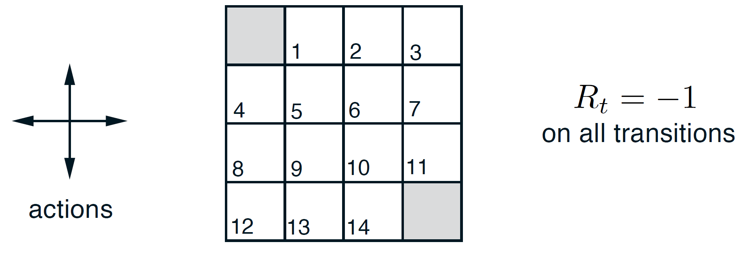
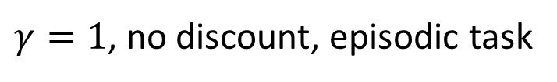
An illustration
Terminal states
$γ=1$, no discount, episodic task

Slide 19
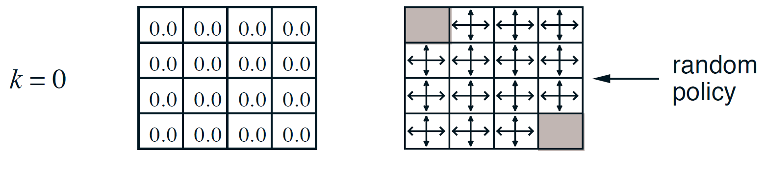

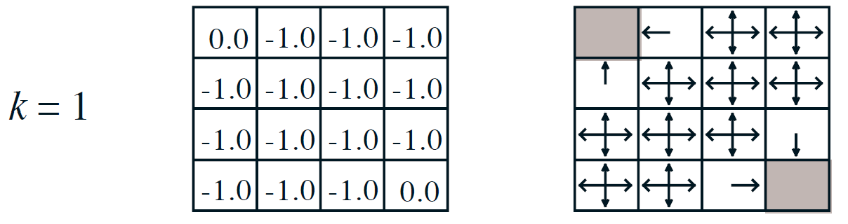
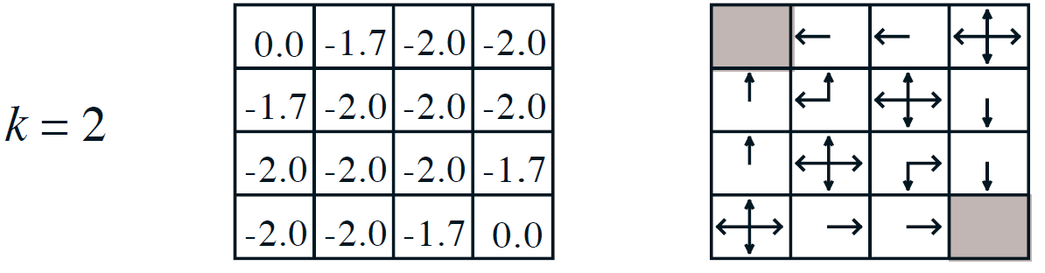

An illustration
$$v_{k}$$

Slide 20
  Recap: iterative policy evaluation
But will it stop and correctly converge?
Complexity?
$$O(\left|A\right|×{\left|S\right|}^{2})$$
Asynchronous value update!
Essentially a fixed point iteration method.

Slide 21
Recap: Bellman expectation backup is a contraction mapping
Bellman expectation backup operator
  $Γ_{π}(V)=R_{π}+γP_{π}^{ss′}V$
  It is a $γ$-contraction
  $${\left\|Γ_{π}\left(V\right)−Γ_{π}\left(U\right)\right\|}_{∞}=\left\|\left(R_{π}+γP_{π}^{ss′}V\right)−\left(R_{π}+γP_{π}^{ss′}U\right)\right\|$$
  $$={\left\|γP_{π}^{ss^{′}}\left(V−U\right)\right\|}_{∞}$$
  $$≤γ{\left\|V−U\right\|}_{∞}$$
Converge exponentially fast!

Slide 22
Recap: policy improvement
Policy improvement theory
  Denote $π$ and $π′$ as two deterministic policies, if $∀s∈S$ we have $q_{π}\left(s,π^{′}\left(s\right)\right)≥v_{π}(s)$, then $v_{π′}\left(s\right)≥v_{π}(s)$
Keep expanding by definition, until hit all states

Slide 23
Recap: an illustration
$$v_{k}$$

Slide 24
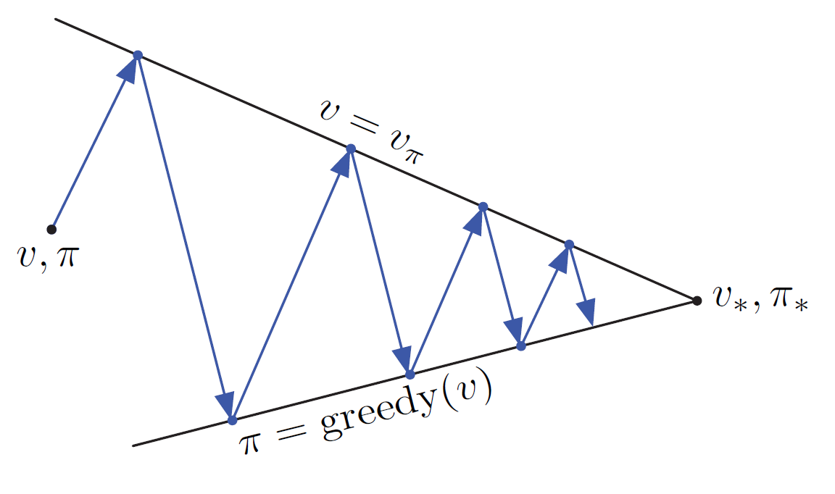

Policy iteration
Another contraction!
Iteratively improve the policy
  Policy evaluation $→$ where can be improved
  Policy improvement $→$ get the next policy to be evaluated
Like an EM algorithm?
Complexity?
Do we need to wait for exact policy evaluation?
Exponential convergence!

Slide 25
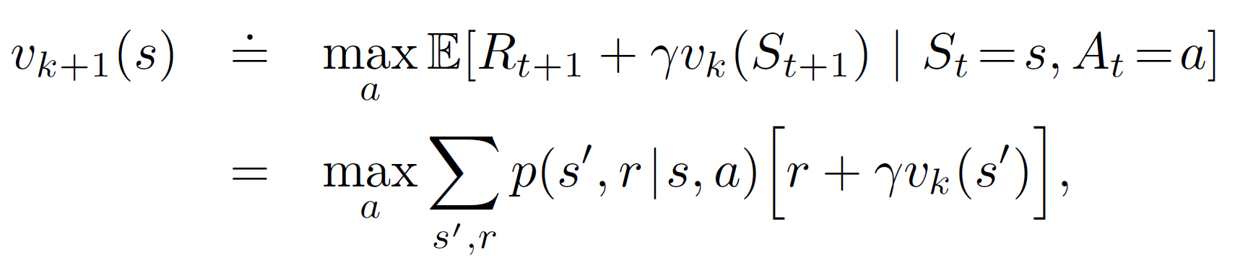
Value iteration
Perform policy improvement right after one iteration of policy evaluation
Policy improvement
Policy evaluation for only one step
No explicit policy, which is induced by the updated value function (i.e., take the best action)

Slide 26
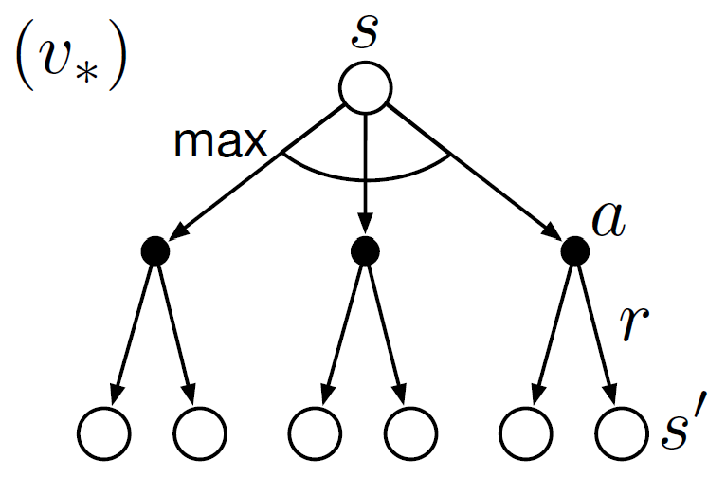
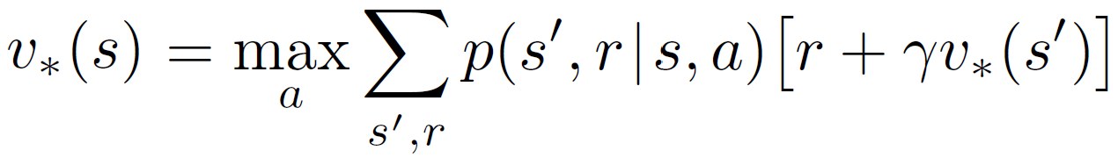

Principle of optimality
A policy $π\left(s\right)$ achieves the optimal value from state $s$, $v_{π}\left(s\right)=v^{∗}(s)$, if and only if,
  For any state $s′$reachable from $s$
  $π$ achieves the optimal value from $s′$, $v_{π}\left(s′\right)=v^{∗}(s′)$
Recurring sub-problems
Optimal substructure
Bellman optimality equation!

Slide 27
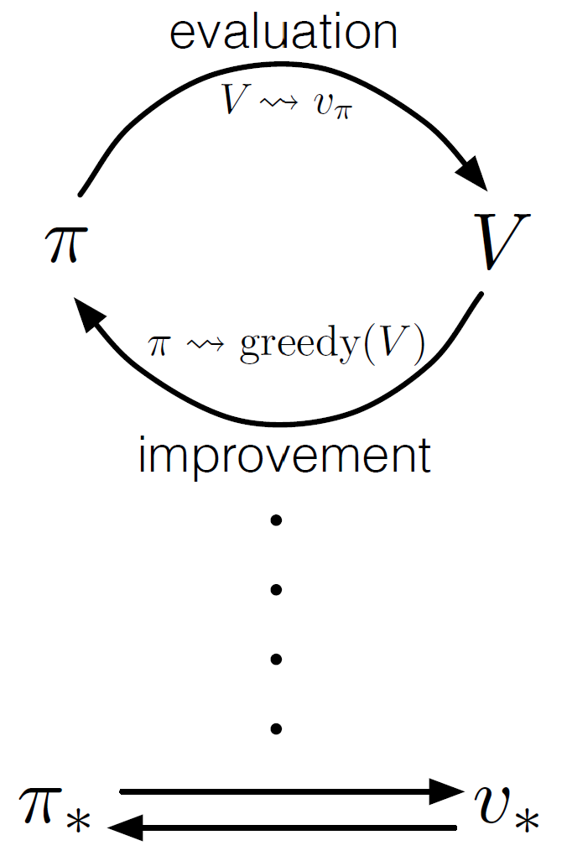
Generalized policy iteration
Any evaluation method
Various ways to perform policy evaluation
  Asynchronous policy evaluation
  Finite step policy evaluation
Various ways to improve the current policy
  For all states
  At least one state
  A subset of states
Any improvement method
Generalized EM algorithm?

Slide 28
Complexity of dynamic programming
Typically it is quadratic to the number of states
  At least one has to sweep through all the successor states for policy evaluation or improvement
  Key performance bottleneck in practice
Approximations!
  Sample backups – using sampled rewards and successor states
  Functional approximation of the value function
Monte Carlo methods!
Q-learning!

Slide 29
Takeaways
Policy evaluation is for a given policy under a known environment
Policy evaluation guides policy improvement
Great flexibility in generalized policy iteration

Slide 30
Suggested reading
Chapter 4: Dynamic Programming

